Slide 1
Day 5 - Strings
Math 495R (Sec 9) - Competitive Coding

Slide 2
Business
First grades up! Let me know if there are any problems
New Problem Set! Due Saturday

Slide 3
Strings
Immutable lists of Unicode
Each operatoin +, += or indexing returns a NEW STRING. EXPENSIVE
Avoid using these operations in loops AT ALL COSTS

Slide 4
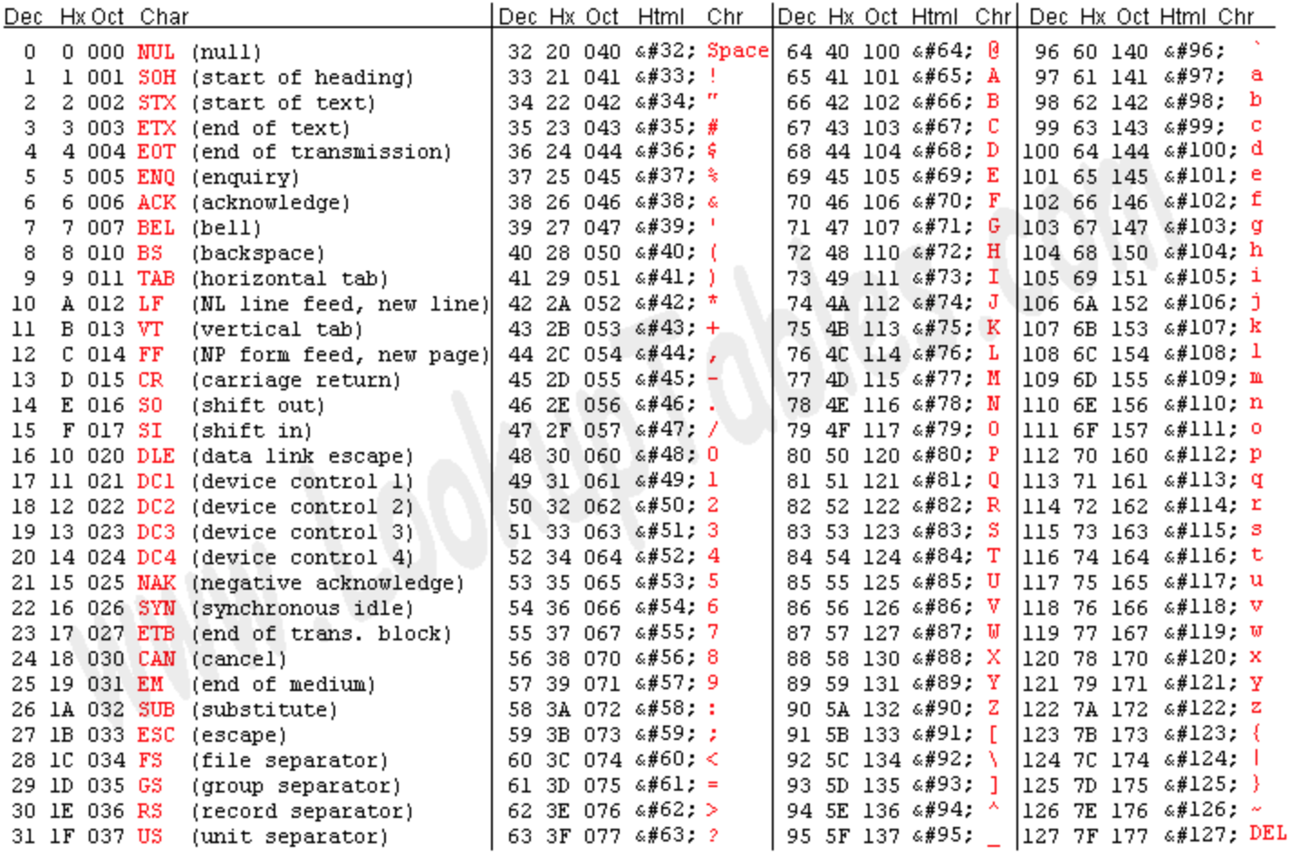
UNICODE / ASCII
Immutable lists of Unicode

Slide 5
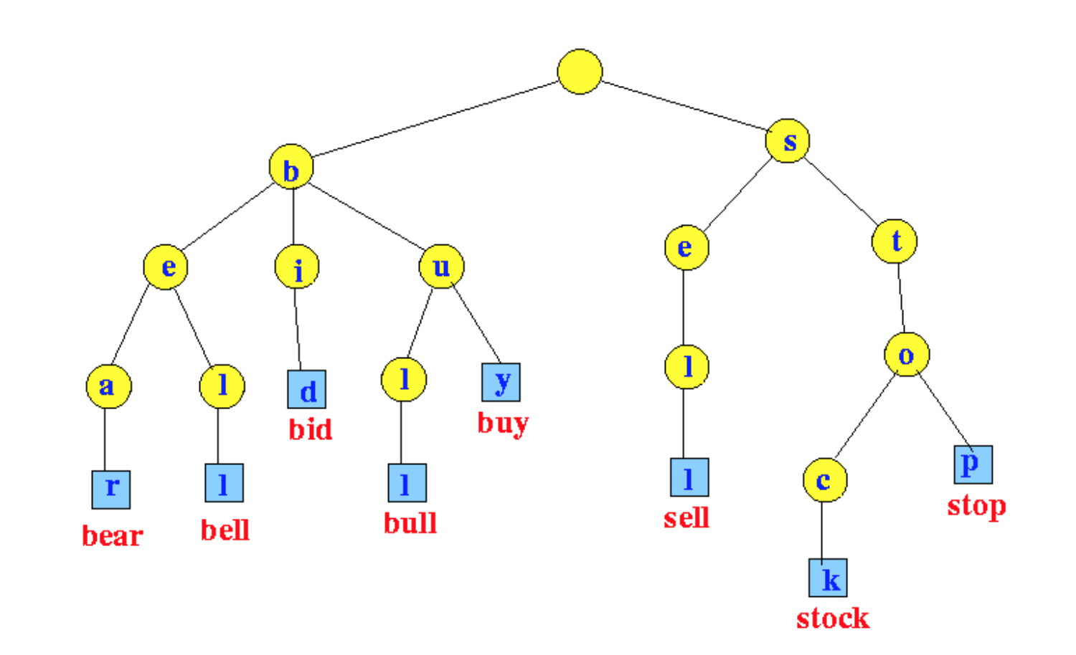
Tries
Add, Find, Prefixes - O(n)
Can be implemented as class or as a dictionary of dictionaries, with functions
Often need “count” or “end” attribute

